Slide 1
Overview of the J.J. Pickle Research Campus
William Powers, Jr.
President
The University of Texas at Austin
November 10, 2011
Academic Affairs Committee

Slide 2
The History of the J.J. Pickle Research Campus
During WWII: Plant to produce magnesium from ore mined in Texas.
September 21, 1946: Contract between U. T. Austin and the War Assets Administration for a 20 year lease with an option to purchase.
Lease contract value of $14,754,936 to be made “in performance of research for the public good.” The facility is named the “Off Campus Research Center” (OCRC) by President T. S. Painter.
On December 20, 1949, U. T. Austin exercises its option to buy the property.
On May 1953, Judge James Hart (first U. T. System Chancellor) renames the OCRC the “Balcones Research Center” (BRC).
In 1974, U. T. Austin purchased 83 additional acres west of Mopac and built facilities for U. T. Austin-Industry projects and the Microelectronics Computer Corporation (MCC).
On March 30, 1994, the BRC is renamed the J.J. Pickle Research Campus (PRC), after Congressman J.J. “Jake” Pickle.

Slide 3
Research & Development (R&D) Awards to PRC Units Over the Last Five Years (in Thousands of Dollars)

Slide 4
Federal and Industry R&D Expenditures at Universities WITHOUT a Medical School for FY 2009 (in Thousand of Dollars)
SOURCE: National Science Foundation/Division of Science Resources Statistics,
Survey of Research and Development Expenditures at Universities and Colleges, FY 2009.

Slide 5
The Impact of a Medical School

Slide 6
The Texas Landscape

Slide 7
Research Drivers at PRC
Focus on:
National and Regional Needs
Large Scale Projects
Collaborations with Industry and Academia
Impact
(examples follow)

Slide 8
Applied Research Laboratories
Founded in 1945 and one of five of the U. S. Navy’s University Affiliated Research Centers (others: John Hopkins, Penn State, University of Washington, and University of Hawaii)
Technology Areas
Submarine Sonar
Undersea Surveillance
Global Positioning System
Mine Countermeasures
Communications and Telemetry for Sensor Networks
Waterside Security Systems

Slide 9
Center for Electromechanics
Primary Focus
Designs, builds, and tests first-of-a-kind devices and systems
Provides technology and advice to the government
Transfers products and technology to industry
Technology Areas
Electric Power: Advanced generators, electric grid control, electromagnetic launch
Defense: Aircraft launcher, all electric ships
Transportation: Advanced trains, active suspension vehicles, intelligent highways
Biotechnology: electromechanical cell manipulation

Slide 10
Bureau of Economic Geology
Oldest Organized Research Unit at U. T. Austin (founded in 1909)
Industry Partnerships:
Industrial Affiliate Programs
10 basic research programs led by researchers with international reputations
~ 100 global companies as members providing $5 million of total annual support
Advanced Energy Consortium (AEC)
Leading international program on pre-competitive research on micro- and nano-sensors for oil and gas
Collaborating and supporting 25 universities worldwide with over 100 students involved
10 major corporate members providing $10 million a year
Gulf Coast Carbon Center
Major integrated program studying geologic carbon sequestration
Actual injection of more than 2 million tons of CO₂ in several US sites
$50 million federal funding and major industrial funding
25 international university and industrial partners
Research involves student and Post Doc education

Slide 11
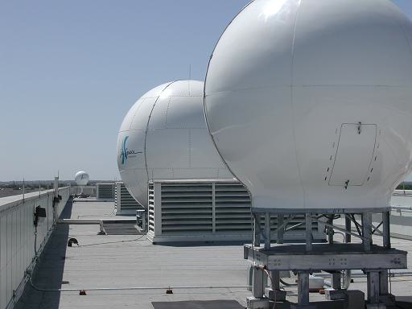
Center for Space Research
GRACE (Gravity Recovery and Climate Experiment)
Makes detailed measurements of Earth's gravity field, which lead to discoveries about Earth's natural systems.
MAGIC (Mid-American Geospatial Information Center)
Monitors in real time wildfires, flashfloods, tornadoes, dust storms, oil spills, red tide outbreaks, and other natural and man-made disasters that affect the region.
Three antennas at the Center for Space Research provide downlink capability and deliver multiple real-time remote sensing data to users.

