Slide 1
THE UNIVERSITY OF TEXAS SYSTEM POLICE 2021 Annual Report May 2022
Michael J. Heidingsfield Director of Police

Slide 2
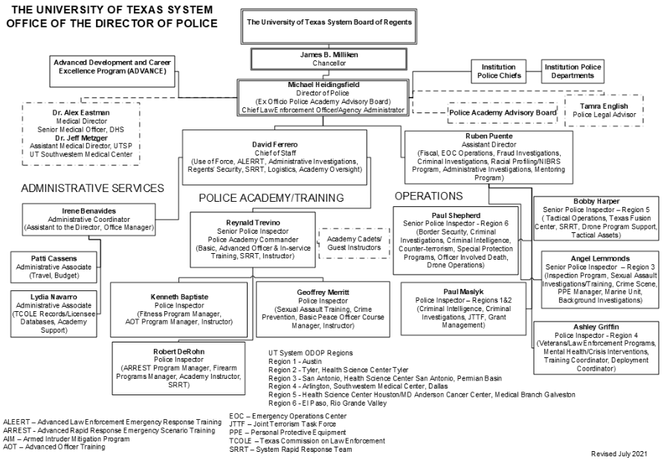
ODOP Staff Organization

Slide 3
ODOP Mission Statement
The University of Texas System Office of the Director of Police (ODOP) is charged with the responsibility of protecting the life and property of individuals who comprise the student body, faculty, and staff of The University of Texas System community.
To oversee and guide the delivery of police services
To train, develop and mentor
To set the national standard for law enforcement at America’s educational institutions
To always respect the principal purpose for a university: to educate our young people in a safe and secure environment
To operate in every location as a full-service law enforcement agency
To rely on the standards of national and state law enforcement accreditation, model policies and evidence-based best practices
To set the expectation that our statutory obligations as peace officers shall be fulfilled and executed
To identify emerging trends in public safety
To support the institutions’ law enforcement agencies with rapidly deployable special assets, advisors and resources
To continually advance the science and delivery of police training and education
To provide advice, counsel and guidance to institution police chiefs and their staffs

Slide 4
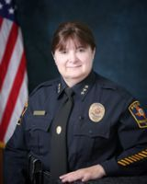
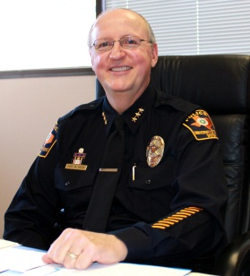
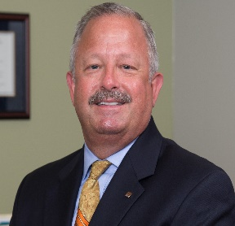
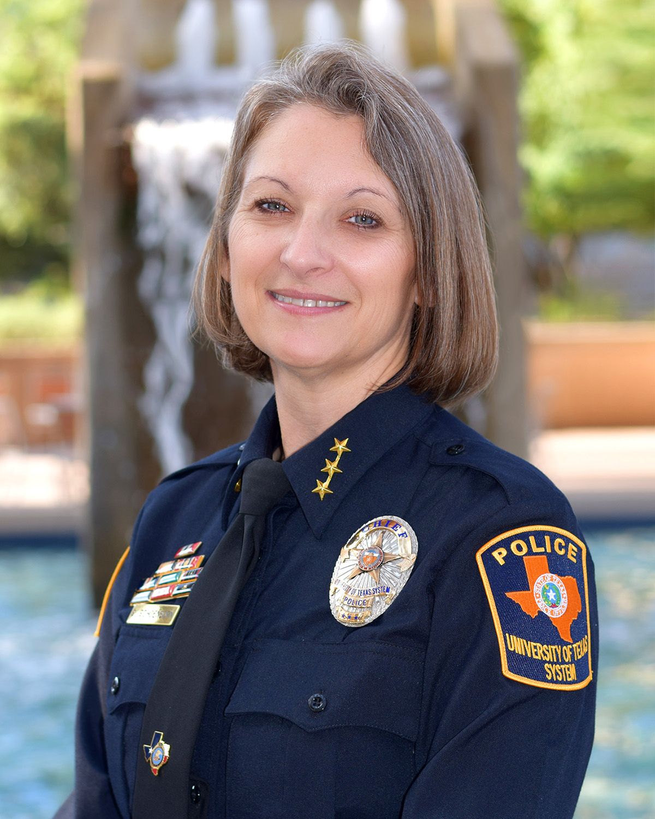
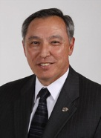
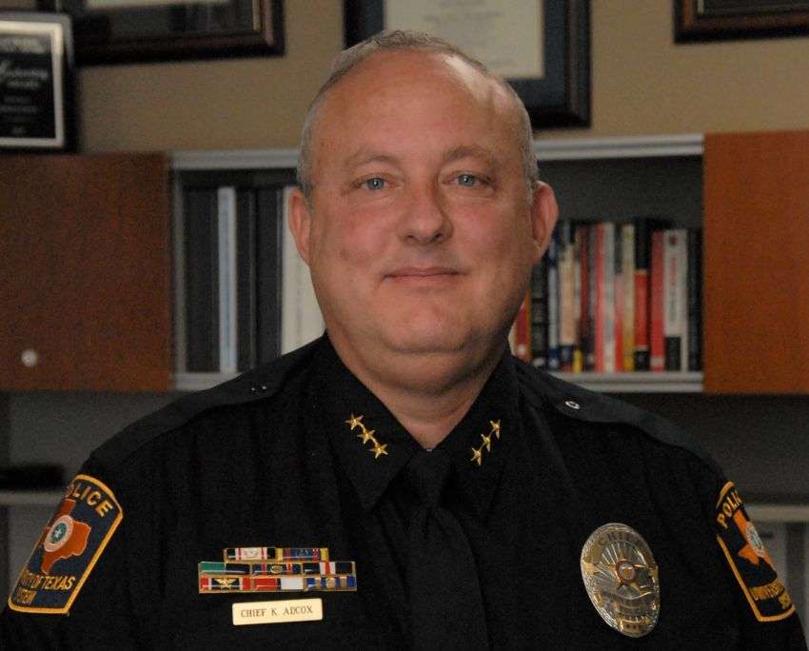
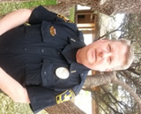
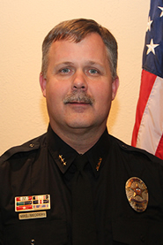
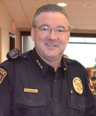
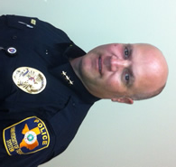
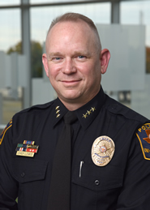
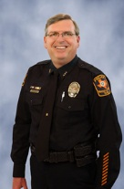
ODOP Mission Statement
To foster the fullest cooperation, communication and coordination between the Director of Police and the institution chiefs
To continually improve the quality of candidates chosen for selection as police officers

Slide 5
ODOP History
Created by the State of Texas Legislature in the wake of the active shooter event of August 1, 1966, The University of Texas System Police charter was to ‘…employ and commission peace officers for the purpose of protecting life and property…’ at the campuses of The University of Texas System or wherever else U. T. interests or assets were represented or present. This decision was followed by the creation of the Office of the Director of Police and The University of Texas System Police Academy in 1968 and thus began the 55+ year legacy of which we are a part today.

Slide 6
ODOP History
103 basic peace officer training classes have been successfully conducted with over 2,000 graduates
611 sworn police officers and 822 civilian staff members currently authorized

Slide 7
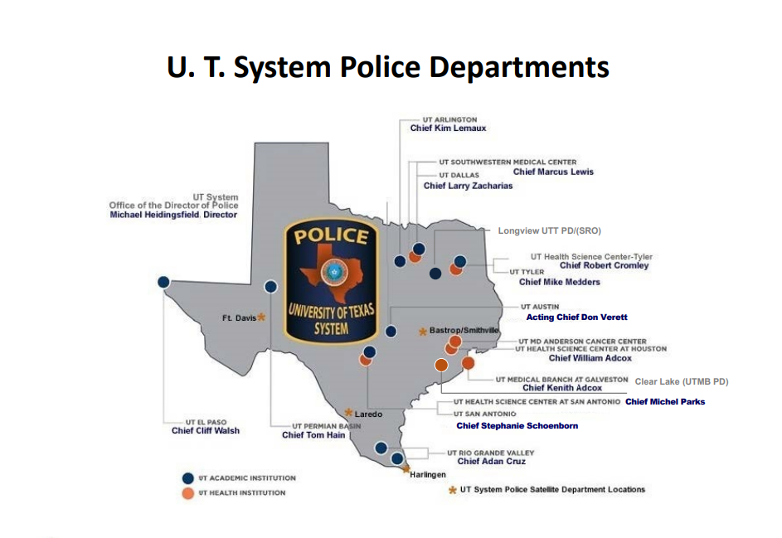

Slide 8
U. T. System Police Personnel
as of December 31, 2021
 | ACTUAL | AUTHORIZED
Commissioned Officers | 519 | 611
Guards/Public Safety Officers | 415 | 489
Telecommunications Officer (Dispatcher)/Other | 112 | 136
Professional Staff | 181 | 197
TOTAL | 1227 | 1441

Slide 9
U. T. System Police Sworn Personnel Strength as of December 31, 2021
Institution​ | Actual Strength​ | Authorized Strength​
Arlington​ | 43​ | 47​
Austin​ | 83​ | 89​
Dallas​ | 26​ | 35​
Southwestern Medical Center​ | 41​ | 48​
El Paso​ | 21​ | 30​
Medical Branch Galveston​ | 65​ | 75​
Houston (Health Science Center + ​ MD Anderson Cancer Center)​ | 71​ | 99​
Permian Basin​ | 14​ | 19​
Rio Grande Valley​ | 48​ | 53​
San Antonio​ | 45​ | 45​
Health Science Center San Antonio​ | 29​ | 37​
Tyler​ | 11​ | 11​
Tyler Health Science Center​ | 8​ | 9​
ODOP (as of 12/31/2020)​ | 14​ | 14​
TOTAL​ | 519​ | 611

Slide 10
U. T. System Police Accredited Departments
Arlington – CALEA & IACLEA
Austin – CALEA
San Antonio – CALEA & IACLEA
Medical Branch - Galveston – CALEA
Health Science Center - Houston/M. D. Anderson Cancer Center – CALEA, IACLEA, TPCA
Health Science Center - San Antonio – IACLEA
Southwestern Medical Center – IACLEA & TPCA
Commission on Accreditation for Law Enforcement Agencies (CALEA)
International Association for Campus Law Enforcement Administration (IACLEA)
Texas Police Chiefs Association (TPCA)

Slide 11
U. T. System Sworn Officers by Gender and Ethnicity As of December 2021
Ethnicity​ | Total by Ethnicity​ |  | Male​ | %​ | Female​ | %​
White​ | 260​ | 50.10%​ | 220​ | 42.39%​ | 40​ | 7.71%​
Black​ | 75​ | 14.45%​ | 61​ | 11.75%​ | 14​ | 2.70%​
Hispanic​ | 175​ | 33.72%​ | 127 | 24.47%​ | 41​ | 7.90%​
Asian​ | 8​ | 1.54%​ | 6​ | 1.16%​ | 2​ | .38%​
American Indian​ | 1​ | .19%​ | 1​ | .19%​ | 0​ | 0​
Asian/Pacific Islander​ | 0​ | 0​ | 0​ | 0​ | 0​ | 0​
Multicultural​ | 7​ | 1.29​ | 7 | 1.35 | 0​ | 0​
​ | 519​ | 100%​ | 422​ | 81.31%​ | 97​ | 18.69%​

Slide 12
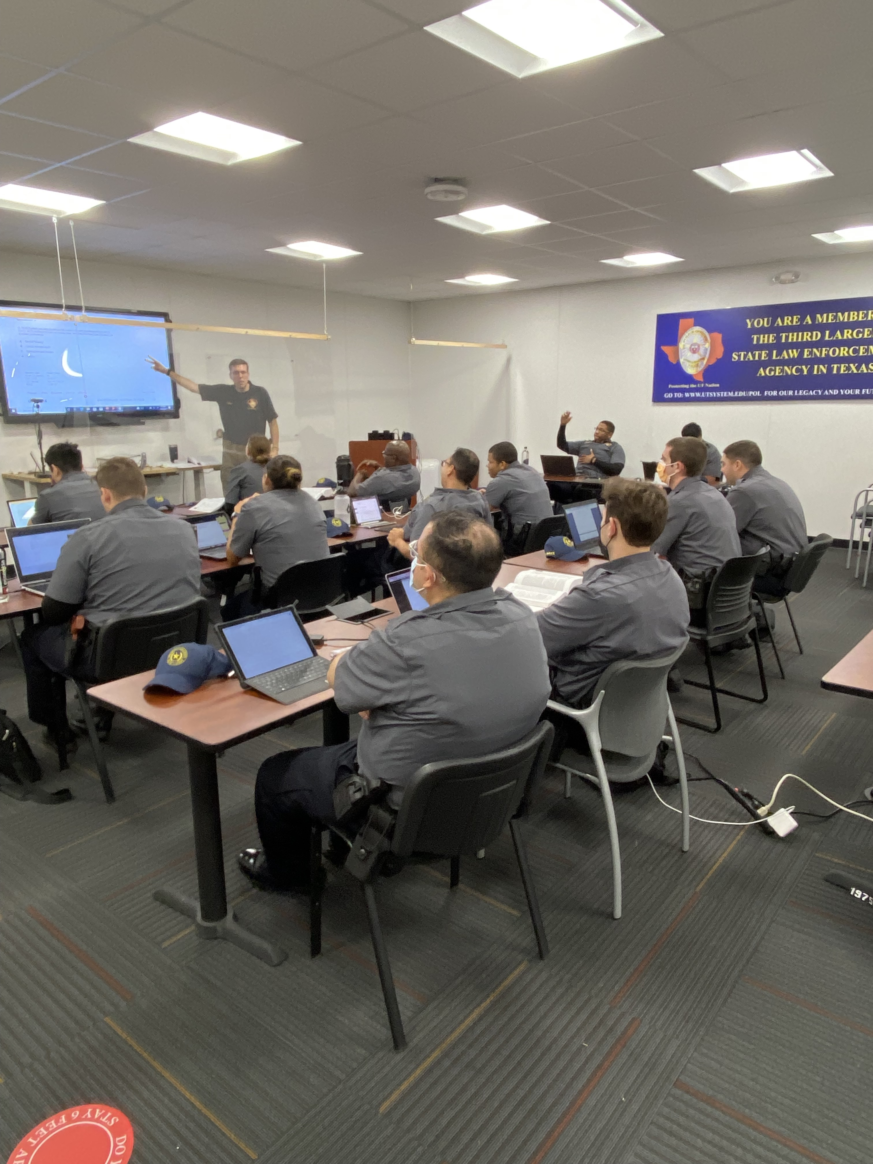
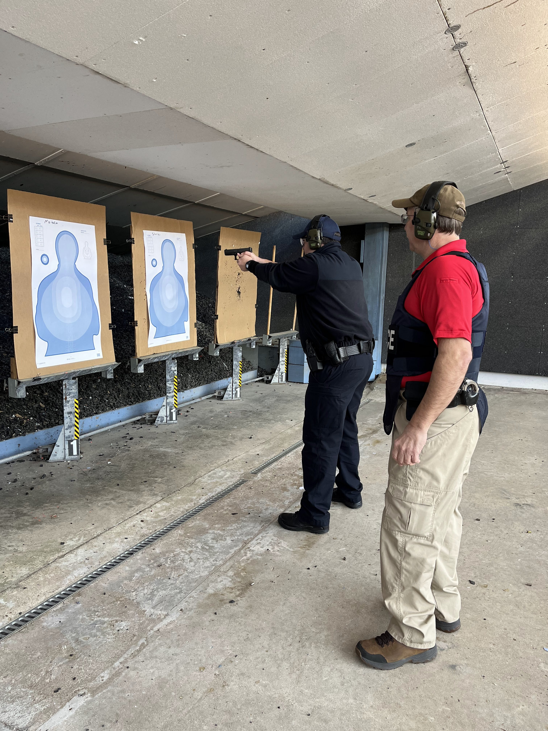
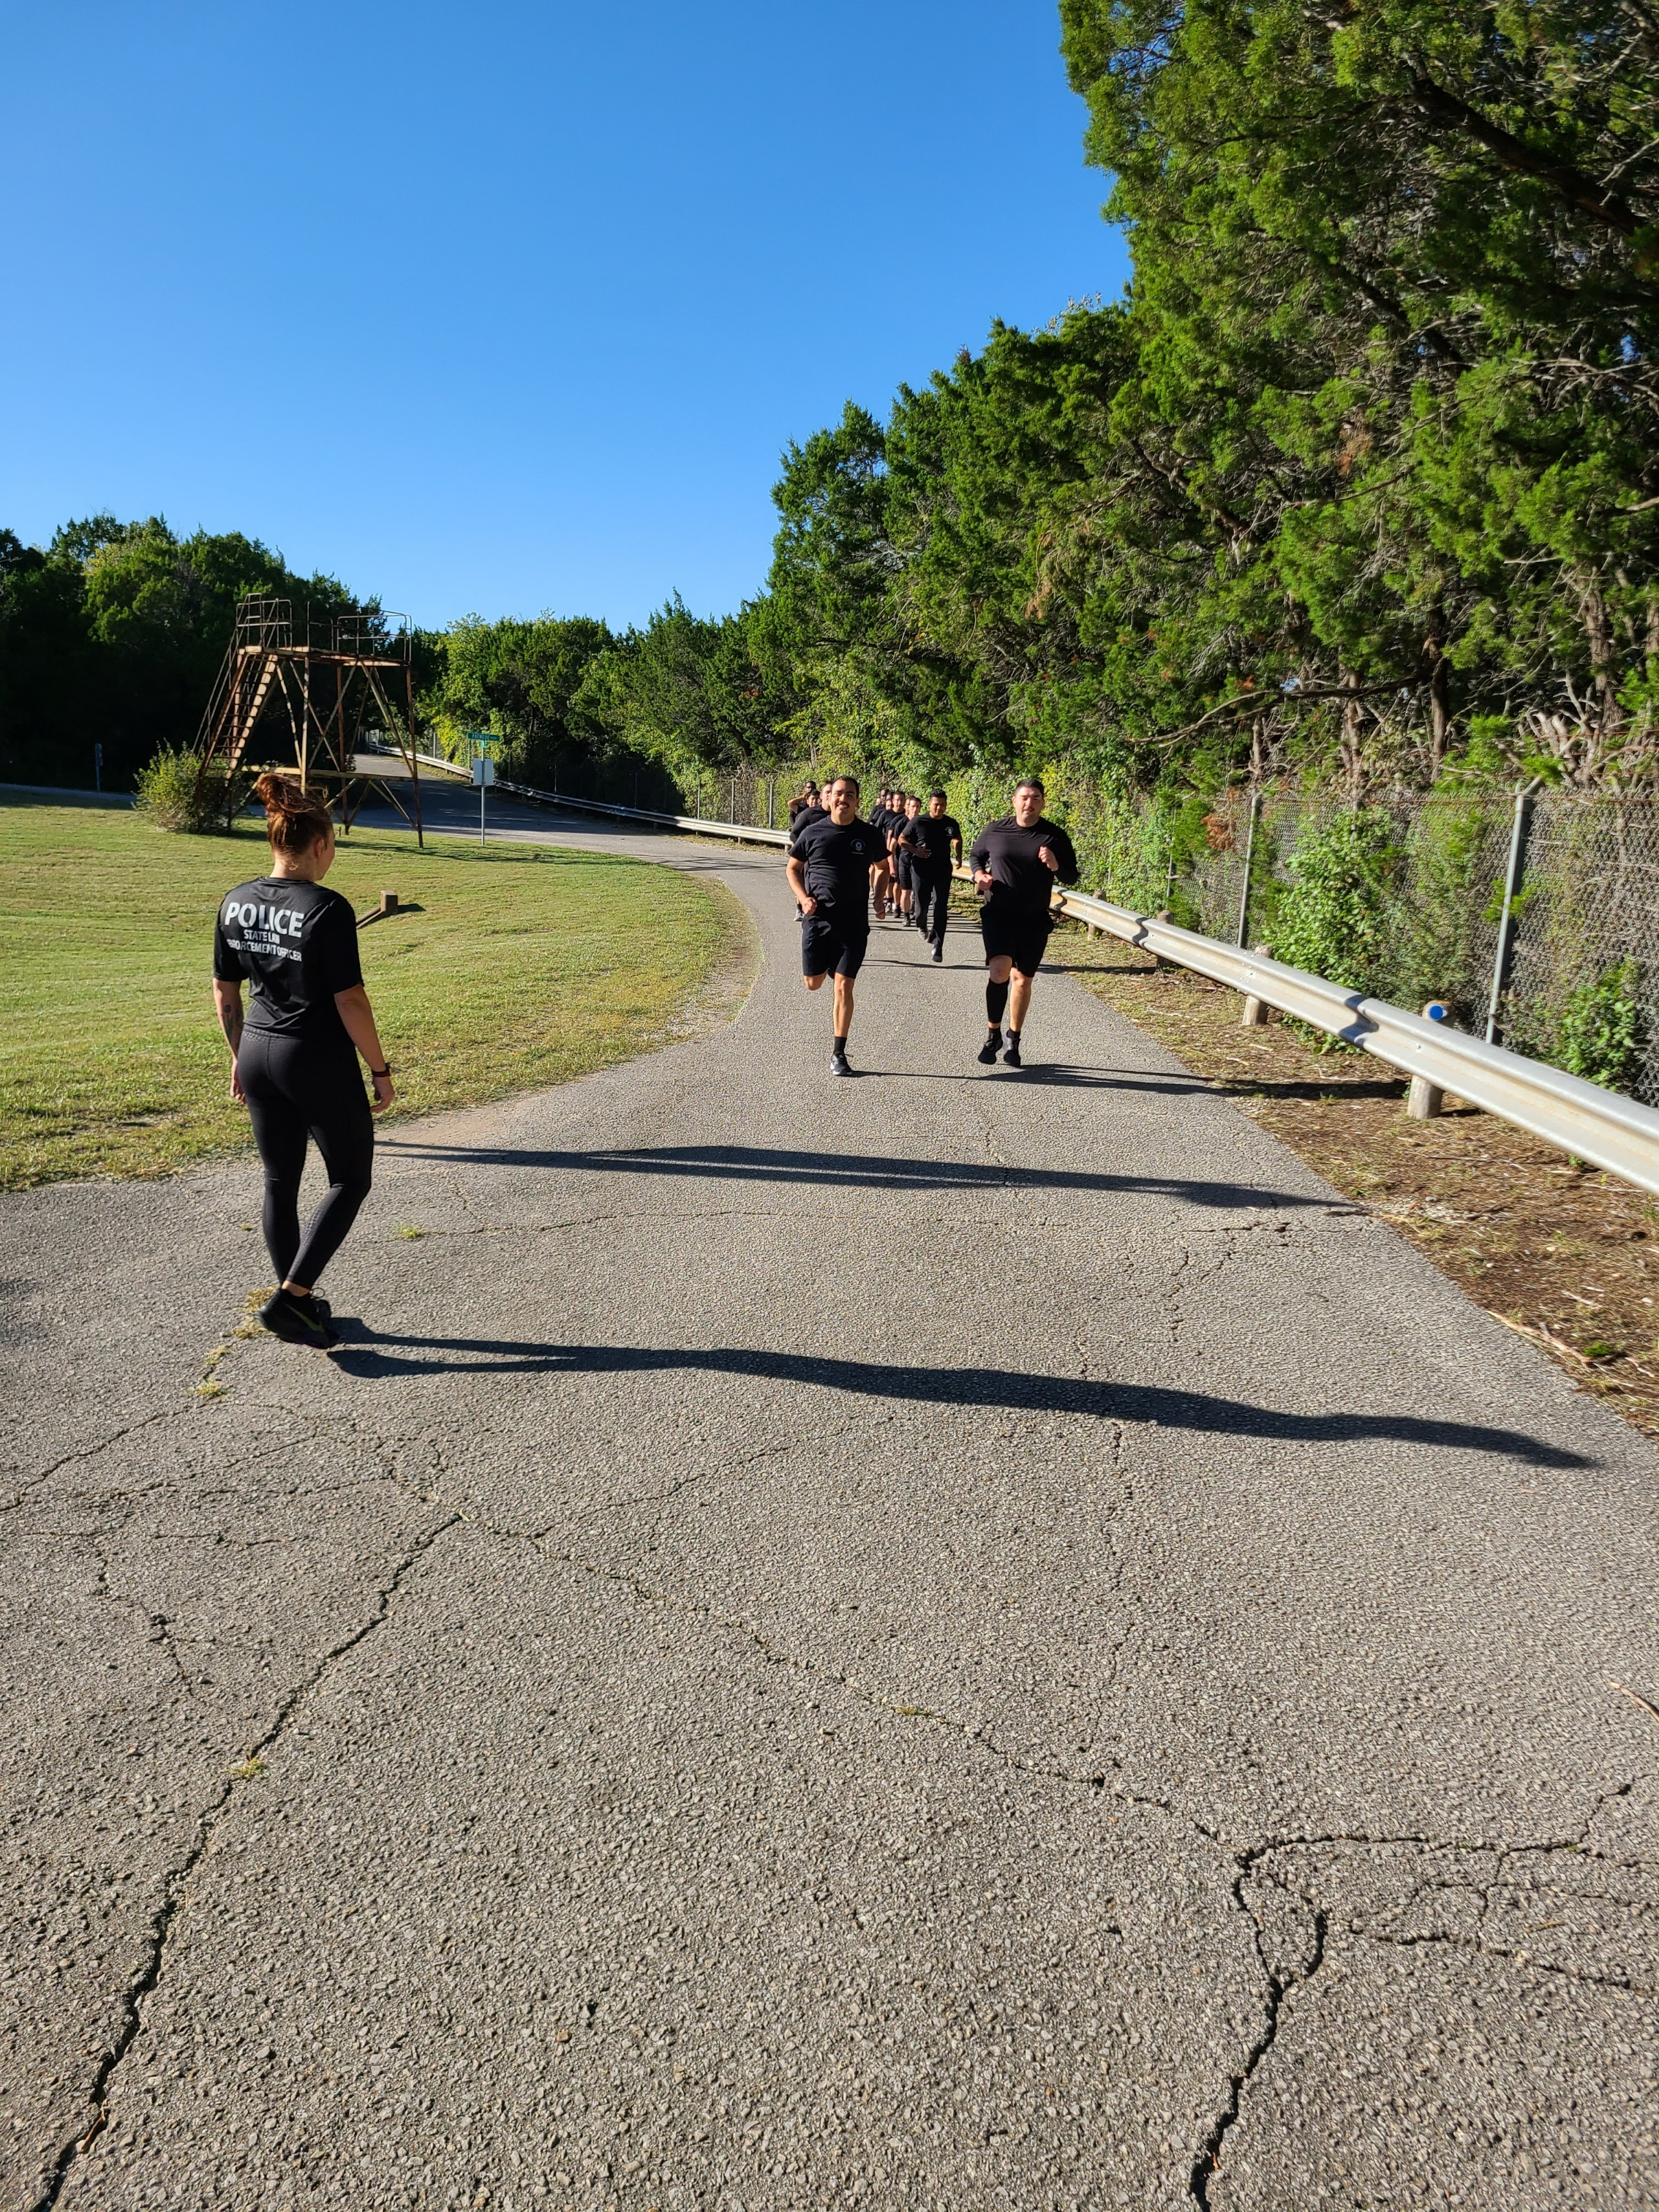
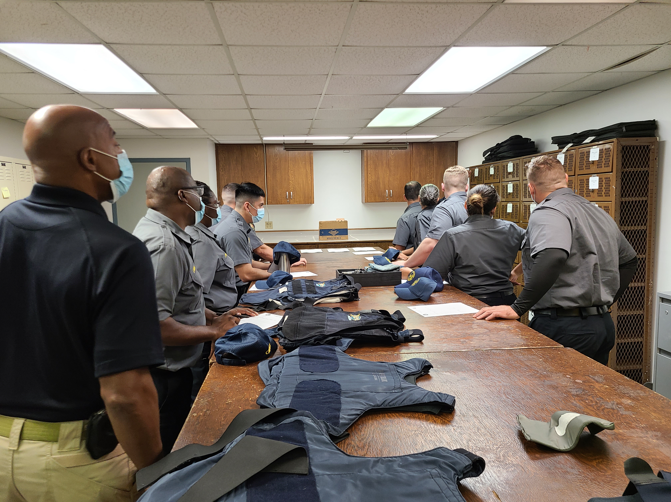
U. T. System Police Academy
Four full-time staff members
Basic Academy – 25 weeks (1010 hours)
18 Consecutive Basic Academy classes passing State Peace Officer licensing exam at rate of 100% on first attempt
In-Service Training
Advanced Rapid Response Emergency Scenario Training (ARREST) including firearms simulator, use of force/ de-escalation, ambush and breaching training
Advanced Officer Course – 4 weeks
99th Basic Training School
University of Texas System Police
January 9 - May 26, 2017
100th Basic Police Officer Class

Slide 13
U. T. System Policy 170 – Oversight of Law Enforcement and Security for the U. T. System
ODOP Responsibility – Director of Police, Agency Administrator and Chief Law Enforcement Officer
Texas Commission on Law Enforcement (TCOLE) considers the U. T. System Police as one state law enforcement agency made up of the Office of the Director of Police and 13 full-service campus police departments
Law enforcement and security standards and practices, staffing levels, training requirements, professional qualifications, police academy, commissioning/revocation authority, inspections, System Rapid Response Team, administrative and criminal investigations, executive and special protection, major crimes team, counterterrorism, intelligence, crime analysis, command & control, promotional process, all police policy

Slide 14
Range of Offenses and Major Incidents Investigated/Responded to by U. T. System Police (Past 12 Months)
Aggravated assault
Aggressive panhandling
Arson
Assault on Peace Officer
Attempt to Disarm Peace Officer
Auto burglary
Auto theft
Bomb threat
Breach of computer security
Burglary
Career Criminal Encounters
Credit card abuse
Criminal mischief
Criminal trespass
Death investigation
Disorderly conduct
Driving while intoxicated
Drug/Alcohol Overdose
Drugs/Drug Smuggling/Drug Diversion
Elopement of Psychiatric Patient
Emergency mental health commitments
Family/dating violence
Felon with Firearm
Felony parole/probation violators
Felony theft
Fire/Arson
Forgery
Fugitive from Justice Arrest
Harassment
Unlawful entry into U.S.
Indecency with child
Invasive visual recording
Interference with emergency communication
Life saving
Missing Person
Possession of child pornography
Prescription fraud
Prohibited weapon
Protective Order Violations
Protests
Public Intoxication
Public lewdness/Indecent Exposure
Resisting arrest/evading arrest
Robbery/Aggravated Robbery
Sexual Assault
Shooting Investigations
Stalking
Stolen firearms
Street Gang Member Encounters
Suicide
Terroristic threat
Unlawful carrying of weapon
Unlawful restraint
Wanted Felon Encounters

Slide 15
National Incident Based Reporting System (NIBRS) Year 2021
The University of Texas System All Institutions Combined |  |  |  |  | Year | 2021
 | GROUP A | NIBRS OFFENSE CODE | TOTAL REPORTED | TOTAL UNFOUNDED | ACTUAL | CLEARANCES (ALL TYPES)
1 | Animal Cruelty | 720 | 1 | 0 | 1 | 0
2 | Arson | 200 | 1 | 0 | 1 | 0
3 | Assault Offenses |  | 723 | 40 | 683 | 490
 | a.) Aggravated Assault | 13A | 20 | 1 | 19 | 13
 | b.) Simple Assault | 13B | 587 | 22 | 565 | 429
 | c.) Intimidation | 13C | 116 | 17 | 99 | 48
4 | Bribery | 510 | 0 | 0 | 0 | 0
5 | Burglary/Breaking & Entering | 220 | 99 | 1 | 98 | 13
6 | Counterfeiting/Forgery | 250 | 31 | 0 | 31 | 10
7 | Destruction/Damage/Vandalism of Property | 290 | 397 | 16 | 381 | 97
8 | Drug/Narcotic Offenses |  | 438 | 2 | 436 | 348
 | a.) Drug/Narcotic Violations | 35A | 302 | 3 | 299 | 244
 | b.) Drug Equipment Violations | 35B | 136 | 0 | 136 | 104
9 | Embezzlement | 270 | 2 | 0 | 2 | 2
10 | Extortion/Blackmail | 210 | 7 | 0 | 7 | 1
Footnote #1: The conversion of Crime Reporting Systems from the FBI Uniform Crime Report (UCR) to the FBI National Incident Based Reporting System (NIBRS) Influences the data captured above; The 2021 crime data should not be used for annual comparisons.
Footnote #2: The Coronavirus Pandemic influenced crime reporting and victimization numbers.

Slide 16
The University of Texas System All Institutions Combined |  |  |  |  | Year | 2021
 | GROUP A | NIBRS OFFENSE CODE | TOTAL REPORTED | TOTAL UNFOUNDED | ACTUAL | CLEARANCES (ALL TYPES)
11 | Fraud Offenses |  | 140 | 21 | 119 | 33
 | a.) False Pretenses/Swindle/Confidence Game | 26A | 39 | 5 | 34 | 12
 | b.) Credit Card/ATM Fraud | 26B | 70 | 6 | 64 | 19
 | c.) Impersonation | 26C | 12 | 2 | 10 | 2
 | d.) Welfare Fraud | 26D | 0 | 0 | 0 | 0
 | e.) Wire Fraud | 26E | 3 | 0 | 3 | 0
 | f.) Identity Theft | 26F | 14 | 7 | 7 | 0
 | g.) Hacking/Computer Invasion | 26G | 2 | 1 | 1 | 0
 | h.) Money Laundering | 26H | 0 | 0 | 0 | 0
12 | Fugitive Offenses |  | 8 | 0 | 8 | 7
 | Harboring Escapee/Concealing from arrest | 49A | 0 | 0 | 0 | 0
 | Flight to Avoid Prosecution | 49B | 8 | 0 | 8 | 7
 | Flight to Avoid Deportation | 49C | 0 | 0 | 0 | 0
13 | Gambling Offenses |  | 0 | 0 | 0 | 0
 | a.) Betting/Wagering | 39A | 0 | 0 | 0 | 0
 | b.) Operating/Promoting /Assisting Gambling | 39B | 0 | 0 | 0 | 0
 | c.) Gambling Equipment Violation | 39C | 0 | 0 | 0 | 0
 | d.) Sports Tampering | 39D | 0 | 0 | 0 | 0

Slide 17
The University of Texas System All Institutions Combined |  |  |  |  | Year | 2021
 | GROUP A | NIBRS OFFENSE CODE | TOTAL REPORTED | TOTAL UNFOUNDED | ACTUAL | CLEARANCES (ALL TYPES)
14 | Homicide Offenses |  | 0 | 0 | 0 | 0
 | a.) Murder and Non-Negligent Manslaughter | 09A | 0 | 0 | 0 | 0
 | b.) Negligent Manslaughter | 09B | 0 | 0 | 0 | 0
 | c.) Justifiable Homicide | 09C | 0 | 0 | 0 | 0
15 | Human Trafficking |  | 0 | 0 | 0 | 0
 | a.) Human Trafficking, Commercial Sex Acts | 64A | 0 | 0 | 0 | 0
 | b.) Human Trafficking, Commercial Servitude | 64B | 0 | 0 | 0 | 0
16 | Immigration Violations |  | 0 | 0 | 0 | 0
 | Illegal Entry into the United States | 30A | 45* | 0 | 45* | 0
 | False Citizenship | 30B | 0 | 0 | 0 | 0
 | Smuggling Aliens | 30C | 0 | 0 | 0 | 0
 | Re-entry after Deportation | 30D | 0 | 0 | 0 | 0
17 | Kidnapping/Abduction (Includes Unlawful Restraint) | 100 | 6 | 0 | 6 | 4
18 | Larceny/Theft Offenses |  | 1085 | 94 | 991 | 150
 | a.) Pocket Picking | 23A | 2 | 0 | 2 | 0
 | b.) Purse-snatching | 23B | 2 | 0 | 2 | 2
 | c.) Shoplifting | 23C | 14 | 0 | 14 | 4
 | d.) Theft From Building | 23D | 334 | 69 | 265 | 52
 | e.) Theft from Coin Operated Machine/Device | 23E | 14 | 1 | 13 | 0
 | f.) Theft From Motor Vehicle | 23F | 145 | 5 | 140 | 28
 | g.) Theft of Motor Vehicle Parts or Accessories | 23G | 101 | 0 | 101 | 2
 | h.) All Other Larceny | 23H | 473 | 19 | 454 | 62
*"Reflects incidents in which assistance was rendered to the US Border Patrol at the Brownsville campus when the international border was crossed unlawfully by persons from Mexico who then trespassed onto the university campus"

Slide 18
The University of Texas System All Institutions Combined |  |  |  |  | Year | 2021
 | GROUP A | NIBRS OFFENSE CODE | TOTAL REPORTED | TOTAL UNFOUNDED | ACTUAL | CLEARANCES (ALL TYPES)
19 | Motor Vehicle Theft | 240 | 82 | 8 | 74 | 23
20 | Pornography/Obscene Material | 370 | 6 | 0 | 6 | 1
21 | Prostitution Offenses |  | 1 | 0 | 1 | 1
 | a.) Prostitution | 40A | 0 | 0 | 0 | 0
 | b.) Assisting or Promoting Prostitution | 40B | 0 | 0 | 0 | 0
 | c.) Purchasing Prostitution | 40C | 1 | 0 | 1 | 1
22 | Robbery | 120 | 13 | 1 | 12 | 8
23 | Sex Offenses |  | 67 | 21 | 46 | 18
 | a.) Rape | 11A | 34 | 9 | 25 | 6
 | b.) Sodomy | 11B | 5 | 2 | 3 | 3
 | c.) Sexual Assault with An Object | 11C | 4 | 1 | 3 | 0
 | d.) Fondling | 11D | 22 | 8 | 14 | 9
 | e.) Incest | 36A | 0 | 0 | 0 | 0
 | f.) Statutory Rape | 36B | 2 | 1 | 1 | 0
 | g.) Failure to Register as a sex offender | 360 | 0 | 0 | 0 | 0
24 | Stolen Property Offenses | 280 | 6 | 0 | 6 | 5
25 | Weapon Law Violations | 520 | 23 | 2 | 21 | 14
 | TOTAL |  | 3136 | 206 | 2930 | 1225

Slide 19
UCR Data – Part II Crimes/Other Information (Criminal Trespass, Fraud/Embezzlement, Criminal Mischief, Weapons Violations, Controlled Substance, DWI, Disorderly Conduct, Public Intoxication, Harassment, Bomb Threats)
The University of Texas System All Institutions Combined |  |  |  |  | Year | 2021
 | GROUP B | NIBRS OFFENSE CODE | TOTAL REPORTED | TOTAL UNFOUNDED | ACTUAL | CLEARANCES (ALL TYPES)
1 | Bad Checks | 90A | 0 | 0 | 0 | 0
2 | Curfew/Loitering/Vagrancy Violations | 90B | 0 | 0 | 0 | 0
3 | Disorderly Conduct | 90C | 108 | 2 | 106 | 85
4 | Driving Under the Influence | 90D | 159 | 1 | 158 | 154
 | Drunkenness | 90E | 115 | 0 | 115 | 94
5 | Family Offenses, Nonviolent | 90F | 4 | 0 | 4 | 4
6 | Liquor Law Violations | 90G | 129 | 0 | 129 | 129
8 | Trespass of Real Property | 90J | 300 | 3 | 297 | 249
9 | All Other Offenses | 90Z | 463 | 10 | 453 | 205
 | TOTAL |  | 1278 | 16 | 1262 | 920

Slide 20
– Other Information
 | 2021
Arrests Custodial (students) | 53
Arrests Non-Custodial (students) | 256
Arrests Custodial (non-students) | 979
Arrests Non-Custodial (non-students) | 261
Life Saving Episodes by Officers | 13
Unlawful Entry/Assist US Border Patrol Brownsville Campus | 45
Involuntary Mental Health Commitments (non-clinical setting) | 138
Suicides | 8
Suicides attempted | 21
*non-custodial arrests – defendants are cited and released on promise to appear in court

Slide 21
Use of Force/Pursuits/Stops 2021 – 2015
​ | 2021 | 2020​ | 2019​ | 2018​ | 2017​ | 2016​ | 2015​
Use of Force – Incidents​ | 131 | 115​ | 124​ | 122​ | 111​ | 78​ | 93​
Taser Use or Exhibition​ | 15 | 13​ | 20​ | 9​ | 7​ | 12​ | 11​
Pepper Spray Use or Exhibition​ | 2 | 0​ | 3​ | 0​ | 0​ | 2​ | 3​
Baton Use or Exhibition | 0 | 0​ | 0​ | 1​ | 0​ | 0​ | 0​
Empty Hand Tactics​ | 164 | 57​ | 74​ | 75​ | 67​ | 48​ | 47​
Exhibit Firearm​ | 43 | 47​ | 26​ | 34​ | 26​ | 17​ | 26​
Use of Firearm ​ | 0 | 1 | 1¹​ | 3²​ | 0​ | 1​ | 0​
Assaults On or Injuries to UT System Police Officers​ | 23 | 3/14​ | 6​ | ​ | ​ | ​ | ​
Attempt to take weapon of UT System Police Officer​ | 4 | 1​ | 3​ | ​ | ​ | ​ | ​
Reported/Recorded Motor Vehicle Stops​ | 10,668 | 11,313​ | 22,352​ | 22,746³​ | 9316​ | 9092​ | 9055​
Pursuits​ | 8 | 10​ | 6​ | 12​ | 9​ | 14​ | 16​
¹Odessa Active Shooter Event
²Three animals euthanized 2018
³The Sandra Bland Act, effective September 1, 2017, changed reporting requirements for motor vehicle stops to
require reporting of warnings issued, as well as tickets and citations.
Footnote #4: The Coronavirus Pandemic influenced reported/recorded motor vehicle stop numbers.

Slide 22
UTSP/ODOP Significant Initiatives & Events – 2020
First Ever UT System Police Peer Support Program Initiative Began
First Ever UT System Police Peace Officer Mental Health Leave Initiative Began
Salary Schedule C Structure For State Law Enforcement Agencies advocated by Office of Director of Police for Institution Police Departments
Policy for Use of Unmanned Aerial Vehicle Finalized
Canine Operations Policy Finalized
Selection of Captain Stephanie Schoenborn as Chief of Police at UT San Antonio
Basic Peace Officer Class #104 Graduated with 100% Passing Rate of the Peace Officer Licensed Exam on First Attempt
Mental Health Professionals/Resources Partnered with Officers at UT Austin PD & UT Health Science Center San Antonio PD for response to those in Mental Health Crisis
University of Texas System Police were one of two Texas Law Enforcement Agencies to be allocated funding for Peer Support Program Development
In Recognition of Exceptional Bravery when responding to an Armed & Threatening patient at the UT Southwestern Medical Center's Clement's Hospital Emergency Room, a cadre of UTSW PD Officers were the recipients of the UT System Police Distinguished Service Cross & Medal of Valor

Slide 23
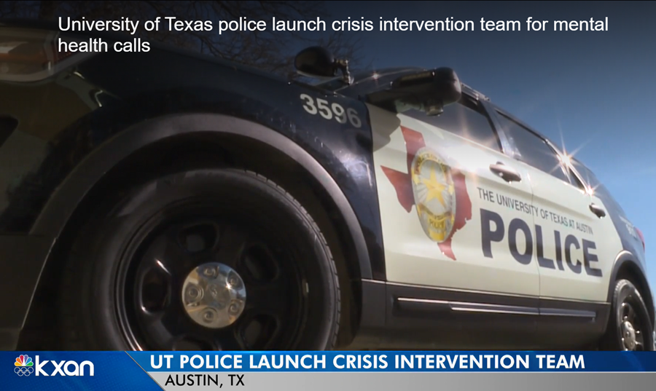
Public Safety Concerns for 2022
Mental Health Encounters
Violence Associated with Public Protests and Demonstrations (Targeted and Indiscriminate)
Active Shooter Threat
Sexual Assault on Campuses
Terrorist Events
Insider Threat
Public Disorder in Communities Immediately Surrounding/Impacting Campuses

Slide 24
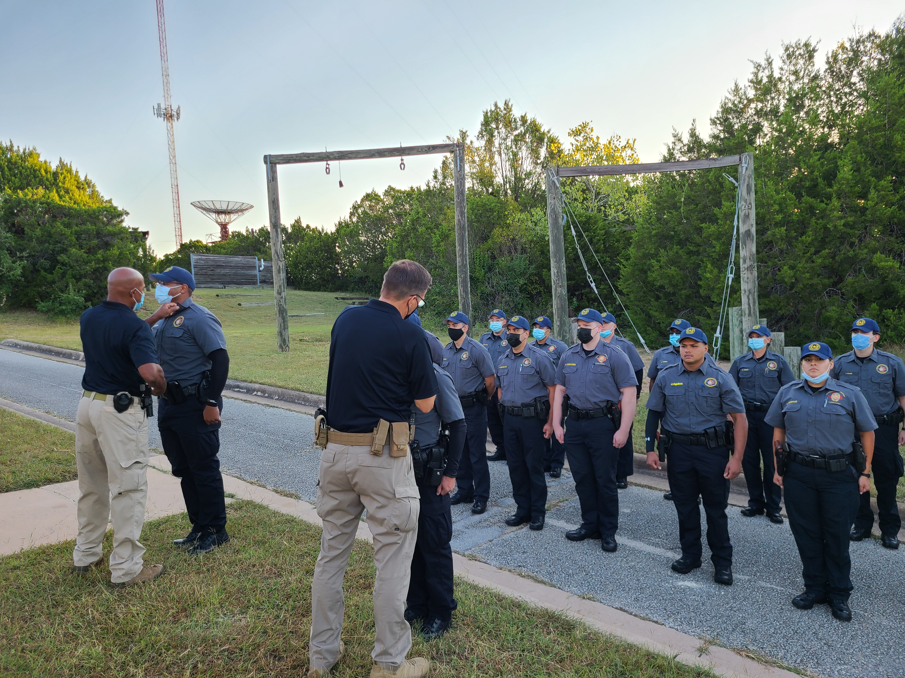
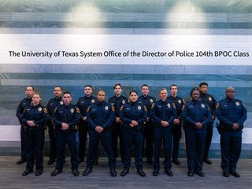
2022 Initiatives
Assist and Support UT Health Science Center Tyler PD in Expansion of Police Services to UT Health East Texas Facilities
Assist and Support UT Health Science Center PD and UT Tyler PD with the Impact of the Merger of the Institutions and the Institution Police Departments
Ensure Public Safety and the Right to Freedom of Speech, Public Assembly and Freedom of Expression are Preserved and Protected at Institutions
Successfully graduate and celebrate our 104th Basic Peace Officer Course
Emerge from the COVID Pandemic with more robust & more resilient learning systems at the UT System Police Academy
Produce new UT System Recruiting/Public Service video to transition from the original 2015 version
Assist in the Transition of Police Services at the UT Laredo Center from UT Health Science Center PD to UTRGV PD

Slide 25
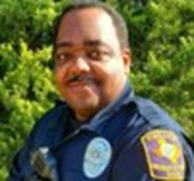
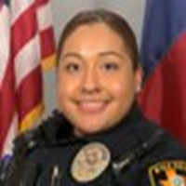
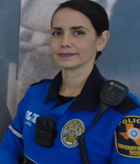
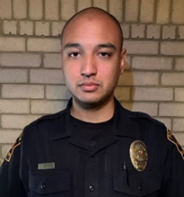
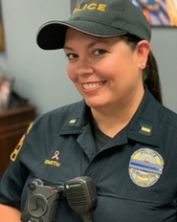
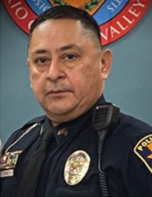
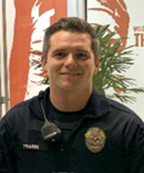
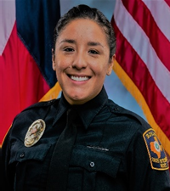
U. T. System Police Officers of the Month Calendar Year 2021
January 2021 February 2021 March 2021 April 2021
Travis Fraser Kendrick Johnson Nancy Medina Michael Funke
UT Permian Basin PD UT Dallas PD UTSW Medical Center PD UTHSC San Antonio PD
May 2021 June 2021 July 2021 August 2021
Elizabeth Villarreal-Arbogast Lonnie Baker Layne Smith Oscar E. Wilhite
UT El Paso UT San Antonio UT Austin UT Houston
September 2021 October 2021 November 2021 December 2021
Francisco J. Lopez Mitchell L. Brannon Trevin Frame Evelyn Castilleja
UT Rio Grande Valley UT El Paso UT Austin UTHS San Antonio

