Slide 1
Doing Business with UT System Administration Overview

Slide 2
Things You Should Know:
.
The University of Texas System Administration (UT System) is different than the other UT Institutions. For example, University of Texas at Austin is an institution of higher education; MD Anderson is a health care institution; and UT System is an administrative entity only.
While UT System is the administrative body for all University of Texas institutions, each educational or health institution has their own Contracts and Procurement Department and their own contracts.
UT System does not purchase on behalf of each campus except for procurements such as Building Insurance, services related to Disaster Recovery, Executive Search Services and Medical Waste Management Services.
All University of Texas institutions have the same purchasing guidelines as mandated by the State of Texas and the Board of Regents of the University of Texas System. (ex. bid requirements, HUB requirements, etc.)
Each campus may have different goals depending on the procurement category

Slide 3
Things to Know
Each campus has different needs
UT System campuses only count state of Texas HUB certified firms toward our diversity goals
UT System campuses use the CMBL (Centralized Master Bidders List) to look for HUB vendors. We also send notifications to minority organizations like TAAACC and TAMACC.
If submitting a proposal on a posted Goods, Services or Commodities RFP, you may need to register in the bid portal (Bonfire) to submit your proposal. Bonfire Strategic Sourcing Software is a company of choice UT System uses to post all UT System formal solicitations, including RFQs, ITBs and RFPs.
Pre-proposal meetings are held before each procurement so those who want to propose can ask questions regarding the RFP.
Construction procurement for major capital construction projects is a totally different procurement process

Slide 4
The University of Texas System
UT System Administration
Goods & Services and Commodities
OCP Major capital construction over $10M for
UTEP, UTD, UTPB, UTT, UTRGV
UT Tyler
Goods & Services and Commodities
Medical equipment and supplies
Campus construction under $10M
UT San Antonio
Goods & Services and Commodities
All Campus construction
UT HSC-Houston
Goods & Services and Commodities
Medical equipment and supplies
All Campus construction
UT El Paso
Goods & Services and Commodities
Campus construction under $10M
UT Rio Grande Valley
Goods & Services and Commodities
Medical equipment and supplies
Campus construction under $10M
UT HSC- San Antonio
Goods & Services and Commodities
Medical equipment and supplies
All Campus construction
UT MD Anderson Cancer Center
Goods & Services and Commodities
Medical equipment and supplies
All Campus construction
UT Dallas
Goods & Services and Commodities
Campus construction under $10M
UT Austin
Goods & Services and Commodities
Medical equipment and supplies
All Campus construction
UTMB-Galveston
Goods & Services and Commodities
Medical equipment and supplies
All Campus construction
UT Southwestern Medical Center
Goods & Services and Commodities
Medical equipment and supplies
All Campus construction
UT Permian Basin
Goods & Services and Commodities
Campus construction under $10M
UT Arlington
Goods & Services and Commodities
All Campus construction

Slide 5
UT System Campus HUB Offices
Goods, Services, Commodities, Medical Supplies and Equipment (if Applicable)
Campus Construction projects under $10M
UT El Paso
Benjamin Alvarez
915-747-5601
baalvarez@utep.edu
UT Dallas
Reginald Cleveland
972-883-4850
Reginald.Cleveland@utdallas.edu
UT Permian Basin
Diana Rodriguez
432-552-2792
rodriguez_d@utpb.edu
UT Tyler-Health
Crystal Smith
903-877-7718
crystal.smith@uthct.edu
UT Tyler-Academic
Paul Fitts
903-566-7461
purchasing@uttyler.edu
UT Rio Grande Valley
Alex Valdez
956-665-7105
alex.valdez@utrgv.edu

Slide 6
UT System Campus HUB Offices
Goods, Services, Commodities, Medical Supplies and Equipment (if Applicable)
All Campus Construction Projects
UT Austin
Tiffany Dockery Gibson
512-471-2863
tiffany.dockery@austin.utexas.edu
UT Arlington
Mario Ramirez
817-272-2149
Mario.ramirez@uta.edu
UT Southwestern Medical Center
Darcel Webb
469-644-5007
Denise.Webb@utsouthwestern.edu
UT San Antonio
Bruce Williams
210-458-6491
bruce.williams@utsa.edu
UTHSC-San Antonio
Rebecca Mendez
210-562-6200
mendezr2@uthscsa.edu
UTMB Galveston
Karen Gross
409-266-1094
klgross@utmb.edu
UTHSC-Houston
Keith Williams
713-500-4862
Keith.w.williams@uth.tmc.edu
UTMDACC
Barbara Howard
713-794-3211
bhoward@mdanderson.org

Slide 7
UT System Administration HUB Office
Goods & Services and Commodities
OCP Managed Major Capital Construction Projects over $10M
Kyle Hayes
512-322-3745
khayes@utsystem.edu
UT El Paso
UT Permian Basin
UT System Administration
Goods & Services
Procurement
Stephanie Park
512-499-4378
spark@utsystem.edu
UT Dallas
UT Tyler
Cynthia Booker
512-322-3779
cbooker@utsystem.edu
UT Rio Grande Valley
Supply Chain Alliance

Slide 8
Goods and Services Procurement

Slide 9
Promotional/ Marketing items and services
IT Development, Design and Temp services
Other Temp services
Facilities/ Grounds maintenance services (all types)
Catering services
Special Trades (electrical, painting, roofing, plumbing, etc.) services
Architectural/ Engineering services
CPA/ Accounting services
Environmental-related services
…and much more!
What we are buying

Slide 10
Our Purchasing Process
UT System Administration utilizes a variety of solicitation methods which are generally determined based on the estimated dollar value (“Thresholds”) of the product or service to be purchased:
Informal Bids - Purchase Value of $15,000 - $50,000
Invitation to Bid (ITB) - Purchase Value Greater than $50,000
Request for Proposal (RFP) - Purchase Value Greater than $50,000
Request for Qualifications (RFQ) - Used for Professional Services
Request for Information (RFI) - Used to Gather Information and Specifications
A department may solicit quotations from suppliers for purchases up to $50,000.
Purchases with a value expected to be greater than $50,000 are managed by the Office of Contracts and Procurement.

Slide 11
Purchases by $$ Thresholds:
Goods/Services <$15,000 (informal bidding not required)
UT System departments solicit quotes/proposals for goods and services from vendors and issue Purchase Orders to vendors.
Qualifying goods and services <$5,000 can also be purchased via Procard (CC).
A list of UT System departments (offices) is available on the UT System Administration website https://www.utsystem.edu/offices

Slide 12
Purchases by $$ Thresholds (cont.):
Goods/Services $15,000 – 50,000 (informal bidding required)
Departments must obtain a minimum of three (3) written bids.
Departments must make a good-faith effort to include bids from certified HUB suppliers; one (1) from a minority-owned business and one (1) from a woman-owned business.
Departments must forward bids to the Contracts and Procurement Office and create a requisition in the PeopleSoft system.
Contracts and Procurement Issues PO to winning Vendor.

Slide 13
Purchases by $$ Thresholds (cont.):
Goods/Services exceeding $50,000 (formal bidding process)
UT System Administration publishes solicitations for goods and services on the UT System Bonfire website when the expected value exceeds $50,000.
These solicitations can also be found on the Electronic State Business Daily (ESBD). Our Agency Number is 720
All formal Goods & Services solicitations (RFP, RFQ, ITB) are published, awarded and managed by the UT System Administration Contracts and Procurement Office

Slide 14
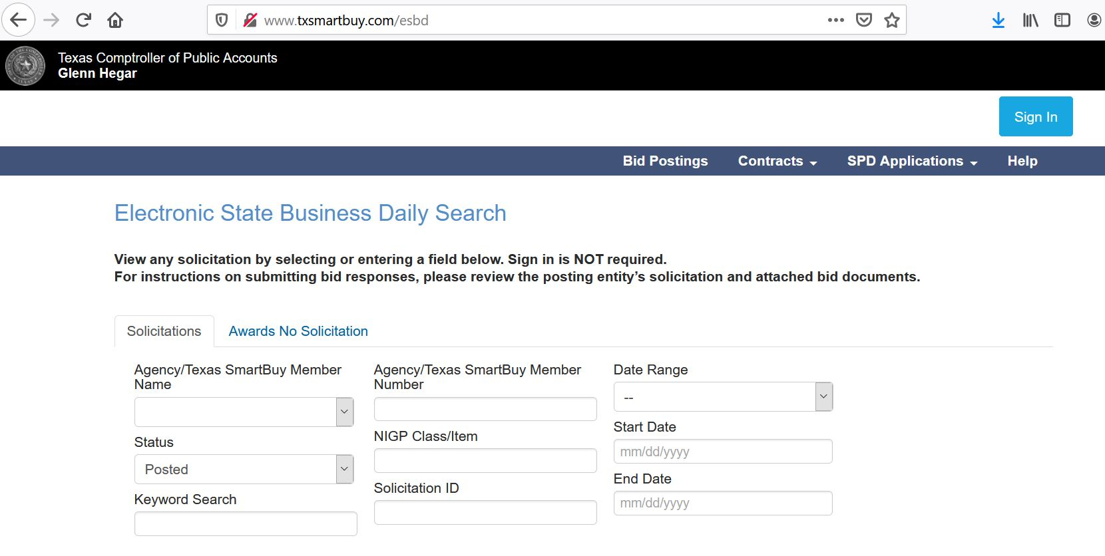
STATEWIDE OPPORTUNITIES RESIDE ON THE
ELECTRONIC STATE BUSINESS DAILY (ESBD)

Slide 15
UT System Campus Agency Codes
720 – UT System Administration
714 – UT Arlington
721 – UT Austin
724 – UT El Paso
738 – UT Dallas
729 – UT Southwestern Medical Center-Dallas
506 – UT MD Anderson Cancer Center
723 – UT Medical Branch-Galveston
744 – UT Health Science Center-Houston
742 – UT Permian Basin
746 – UT Rio Grande Valley
745 – UT Health Science Center-San Antonio
743 – UT San Antonio
785 – UT Health Science Center-Tyler
750 – UT Tyler

Slide 16
Current Open RFPs
RFP | Description of Services | Proposal Due Date
720-2301 | Earth Moving and Caliche Pit Services | Nov 22nd 2022, 2:30 PM CST
720-2302 | Telehealth Services | Nov 28th 2022, 2:30 PM CST
720-2304 | Landscape Maintenance Services | Dec 5th 2022, 2:30 PM CST
720-2303 | Web-Based Educational Training | Dec 12th 2022, 2:30 PM CST

Slide 17
Find out more
To find out more about doing business with UT System Administration,
please contact:
UT System Administration
Office of Contracts and Procurement
(512)579-5143
https://www.utsystem.edu/offices/contracts-and-procurement
UT System Administration
Office of HUB Programs
Kyle Hayes
(512)322-3745
https://www.utsystem.edu/offices/historically-underutilized-business/hub-program

Slide 18
Building Construction Projects OVER $10M Managed by UT System Office of Capital Projects

Slide 19
Upcoming Capital Construction Projects Managed by UT System Office of Capital Projects
Dallas – Stephanie Park, Sr. HUB Coordinator – spark@utsystem.edu
UT Dallas Student Success Center Design AE TBD $61M
Tyler – Stephanie Park, Sr. HUB Coordinator – spark@utsystem.edu
UT Tyler Nursing Addition and Renovation Design AE- Fitzpatrick/CMR-Hoar Construction $23.7M
UT Tyler Science Building Design AE TBD $90M
UTHSC-Tyler UT Tyler Medical Building Sub-Bids Upcoming AE- Fitzpatrick/Skanska-HGR $316M
Skanska HUB Contact: Rosalyn, Email: Rosalyn.asher@skanska.com, Mobile: 313-300-0435
Subscribe to UT System OCP Upcoming Opportunities at
https://apps.utsystem.edu/spo/DisplaySPO.aspx

Slide 20
Links
Centralized Master Bidders List (CMBL)-
https://mycpa.cpa.state.tx.us/tpasscmblsearch/tpasscmblsearch.do
Electronic State Business Daily (ESBD)-
http://www.txsmartbuy.com/esbd
Office of Capital Projects site-
https://apps.utsystem.edu/spo/DisplaySPO.aspx
Agency annual HUB Reports- State Agency Expenditure Data-Detail by Agency
https://comptroller.texas.gov/purchasing/vendor/hub/reporting.php
NIGP Commodity Book
https://comptroller.texas.gov/purchasing/nigp/
UT System Bonfire
https://utsystem.bonfirehub.com/portal/?tab=login

Slide 21
Stephanie Park
UT System HUB Office
Sr. HUB Coordinator-OCP Projects
Phone: 512-499-4378
Email: spark@utsystem.edu
Thank You!

